Slide 1
FUNCTIONAL APPROACH IN CODE
by Ostap Kovbasiuk

Slide 2
WHAT IS FUNCTIONAL PROGRAMMING
Functional programming is a programming paradigm — a style of building the structure and elements of computer programs — that treats computation as the evaluation of mathematical functions and avoids changing-state and mutable data

Slide 3
PURE FUNCTIONS
So how do we know if a function is pure or not? Here is a very strict definition of purity:
It returns the same result if given the same arguments (it is also referred as deterministic)
It does not cause any observable side effects (modifying a global object or a parameter passed by reference)

Slide 4
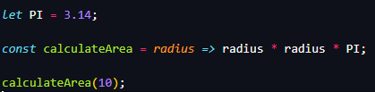
PURE FUNCTIONS
Why it is not pure???

Slide 5
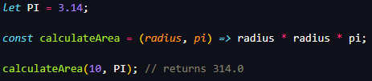
PURE FUNCTIONS
Now it is pure. For the same parameters we will always have the same result.

Slide 6

WHAT IS IMMUTABILITY
It is an unchanging over time or unable to be changed. When data is immutable, its state cannot change after it’s created. If you want to change an immutable object, you can’t. Instead, you create a new object with the new value.

Slide 7
IMMUTABLE ARRAYS
Arrays have several mutable operations - push, pop, splice, shift, unshift, reverse and sort.
Using them is usually causing side effects and bugs that are hard to track.
That’s why it’s important to use an immutable way.

Slide 8

IMMUTABLE ARRAYS
instead of

Slide 9
IMMUTABLE ARRAYS
instead of

Slide 10

IMMUTABLE ARRAYS
instead of

Slide 11
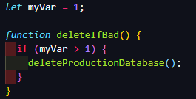
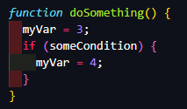
PREFER CONST… BUT WHY?
We write a function that uses some variable declared in an outer scope:
In two months time, someone else comes along and they write another function:
Notes:
What is wrong?
All tests pass
But
Second is invoked first and…

Slide 12
WHY TO AVOID LOOPS
Traditional loops, like for or while, are too low-level for common tasks.
They are prone to off-by-one error (1 more or 1 less iteration).
You have to manage the index variable yourself, and always make typos with length.

Slide 13
WHY TO AVOID LOOPS
Instead we can always use our array functions:
.map()
.filter()
.find()
.some()
.every()
etc.

Slide 14
WHY TO AVOID LOOPS
Instead we can always use our array functions:
.map()
.filter()
.find()
.some()
.every()
etc.

Slide 15

THE PROBLEM OF RECURSION
The recursive function keeps adding entries to the JavaScript engines call stack until there’s no more room, and then we get an error: “Maximum call stack size exceeded”
So, how to solve this?

Slide 16
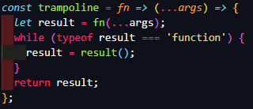


TRAMPOLINES
A trampoline function basically wraps our recursive function in a loop. Under the hood, it calls the recursive function piece by piece until it no longer produces recursive calls.
Rewrite our recursive function:
And result is:

Slide 17
USED LINKS
https://blog.sapegin.me/all/avoid-loops/
https://www.freecodecamp.org/news/functional-programming-principles-in-javascript-1b8fc6c3563f/
https://medium.com/better-programming/never-write-another-for-loop-in-javascript-9db11afa6445
https://blog.logrocket.com/using-trampolines-to-manage-large-recursive-loops-in-javascript-d8c9db095ae3/

Slide 18
THANKS FOR ATTENTION

